Slide 1
Underfitting solutions
Explained for beginners
Husnain Haider

Slide 2
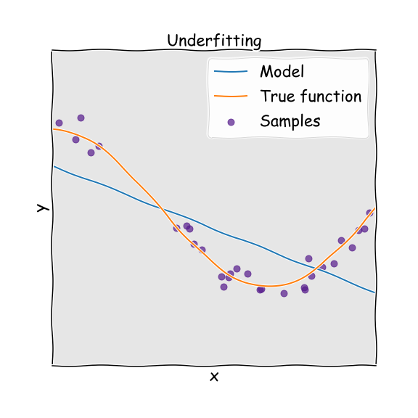
Underfitting?
Underfitting is when machine learning model is unable to learns patterns of the training data
Image Curtsey: Google images

Slide 3
Diagnosis
Results on training data as well as on testing data are very bad
For example, a model gives 30.9% accuracy on training data and 27% accuracy reported on test set, we call this underfitting

Slide 4
Possible solutions
Balance in bias, variance
More training data
Increase training time
Increase number of parameters
Increase complexity of the model

Slide 5
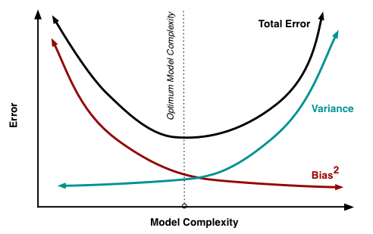
Balance in bias, variance
High bias and low variance leads to underfitting
Low bias and high variance leads towards overfitting
We need a balance between bias and variance for a good fit
Image source: http://scott.fortmann-roe.com/docs/BiasVariance.html

Slide 6
More training data
If we have less data and machine learning model is complex, fitting is not possible
Similar to 5000 cc engine but providing less fuel, vehicle couldn’t work smoothly

Slide 7
Increase training time
Sometime we set less training iterations for a complex model and large data
Model needed more time to train but we stopped training
Stop when error decay is very small for a period of time

Slide 8
Increase number of parameters
More number of parameters means more features to learn
Bigger the storage capacity, better the learning

Slide 9
Increase complexity of the model
Sometimes the problem nature is very complex and we select a simple model for it
For example, problem is non-linear and we select linear regression as our model
We need model complexity according to problem, in case of underfitting our model is less complex, so we increase model complexity

Slide 10






Thank you
Please visit us on:
www.youtube.com/channel/UC8kFF39hsRrFfHM6-7A6APQ
www.aisciences.net
www.instagram.com/aisciences/
www.linkedin.com/company/aiscienceslearn
www.facebook.com/AISciencesLearn
www.twitter.com/AISciencesLearn

